Slide 1
Bundled Pricing Medicare’s New Payment Model
Bundled Payments
What Is It?
How to Manage Bundling Models
Marty Brutscher, McBee Associates

Slide 2
Overview
Bundled Pricing History
Basics of Bundled Payment Models
Creating an Operations Structure

Slide 3
Bundled Pricing History

Slide 4
Bundled Contracts Background
Many providers started negotiating bundled or global pricing contracts in the mid 1990’s
Initial focus was on big ticket inpatient procedures
Primarily negotiated with managed care organizations
Was a mechanism for payers to “fix” their price for high cost cases

Slide 5
Bundled Contracts Background
Typical contract included:
Pre-admission testing
Inpatient stay
All physician services during the inpatient stay
Hospital took risk of keeping cases within the total price paid for case
Negotiated some risk arrangements with physicians
“Carved out” devices and some other high cost items for separate payment

Slide 6
Bundled Model Evolution
Medicare began testing bundled payment model in 1991 with “Participating Heart Bypass Center” demonstration
Included 7 hospitals testing the model for 5 years
Medicare estimated this model saved up to 10% on payments to participants
Biggest hurdle identified was daily operations challenges
Medicare started a second bundling demonstration in 2009

Slide 7
Current Status of Bundled Models
Significant expansion of Medicare demonstration in 2012
Providers beginning to “dip their toes” in the bundling models
Benefit design of many employers making non-COE centers cost prohibitive for employees
Interest for direct employer agreements for specific centers of excellence
Less risk adverse

Slide 8
Basics of Bundled Payment Models

Slide 9
Components of Bundled Payments
Hospital: Inpatient Stays plus pre-admission services, usually some discounting from charges or per diem rates
Physician:
Risk physicians: paid pre-determined amount minus withhold
Consulting physicians: paid at a % of charges
Withhold returned based off of quality metrics
Home Care, Housing, Pharmacy: Part of new models with post acute part of bundle
Annual Reconciliation
Gainshare: overall profitability per procedure type
Withhold
Excess funds in consult pool

Slide 10
Examples of Quality Reporting Requirements
Current contracts require online access for payers to UNOS, NMDP & ASBMT, some unique requirements
CMMI BPCI initiative requires monitoring
Hospital IQR Measures
Physician Quality Reporting System
Generic Quality Measures and Quality Improvement Program

Slide 11
Requirements for Success
Physician cheer leader
Clearly define episodes covered including:
Start/stop dates
Inclusions/exclusions
Carve outs
Access to current experience: hospital, physician, home care, pharmacy

Slide 12
Requirements for Success
Strong financial and clinical analytics support
Approval structure for contractual requirements
Reporting requirements: Financial, Clinical & State
System that includes following:
Calculates expected payment for bundled episode
Claims processing
Quality tracking and reporting
Financial reporting

Slide 13
CMMI Bundled Payment for Care Improvement Models
Model 1: Inpatient stay only; Retrospective Payment Bundling
Model 2: Inpatient stay plus Post-Discharge Services
Model 3: Post-Discharge Services Only
Model 4: Inpatient stay only: Prospective Bundling

Slide 14
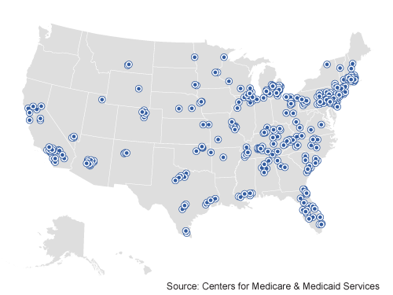
CMMI Bundled Payment for Care Participating Locations

Slide 15
Bundling Operations Structure
Daily Data Requirements
Claims
General Ledger
Reports

Slide 16
Daily Processes
Identifying global patients at time of service
Calculating the expected payment and services included in bundle
Creating splits for each entity included in expected payments
Billing payers and processing claims
Ongoing accounts receivable and claims management

Slide 17
Calculating Payments
Following data required
Admit date, procedure date, discharge date
Coding of MS-DRG
Manual review of itemized hospital, physician and other claims
Clinical review to ensure appropriateness to be billed via bundled rate

Slide 18
Claims Payment
Establishing ability to pay variety of claims types
Hospital, Physician, Home Care, Housing, Pharmacy
Manual build , if necessary
Creating the following:
Denial reasons
Rejection reasons
Duplicate claims – system sends warning
Importing claims from various providers

Slide 19
Claims Payment and Risk Pool
Payments are made bi-monthly only after global rate payment received
Reports detail amount of payment and to which department/entity
Patient identifiers along with invoice on report to ensure appropriate posting
Administrative/clinical denials are rare
Risk pool management
Monitored; but only paid out once a year

Slide 20
IBNR
General
Accrual of estimated total charges per case; based on historical trends of completion factors for each type
Specific cases
Manual entry to monthly financials based on individual clinical presentation

Slide 21
Reporting Requirements
Monthly reporting requirements
Volume
P&L by payer
P&L by procedure type
Withhold accruals
Consult pool
Ad hoc reports

